Slide 1
https://github.com/bczhangbczhang
https://github.com/bczhangbczhang/Gabor-Convolutional-Networks
Gabor Convolutional Networks
@article{GaborCNNs, title={Gabor Convolutional Networks}, author={Luan, Shangzhen and chen, chen and Zhang, Baochang* and han, jungong and Liu, Jianzhuang}, year={2018}, IEEE Trans. Image processing. }

Slide 2




CONTEXT
about
about
about
about
Gabor Convolution Networks
Introduction
Related Works
Experiments

Slide 3

Part 1
about

Slide 4
Haar + boosting
Introduction
Hand-crafted
HOG + SVM
Feature Design
…...
Gabor filter
Lenet, Alexnet, VGG,
GoogleNet, ResNet
Deep feature
Spatial Transformer Networks (STN)
Oriented Response Networks (ORN)
Deformable convolutional network…

Slide 5
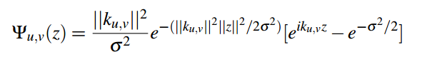
Introduction
--Gabor Filter
Large scale kernel
Small scale kernel

Slide 6
Introduction
--Gabor filter
Visualization of the first Convolution layer in Alexnet
2D Gabor Filter Bank
How about Gabor+CNN？

Slide 7

Part 2
about

Slide 8
Related works
--A review of DCNNS
Reducing the dimensionality
of data with neural networks
VGG16,VGG19
2014
RESNET
2015
Lenet1998
Hinton
2006
Alexnet
2012
GOOGLENET
2015
….
R-CNN
SPP-NET
2014
Fast
R-CNN
2015
Faster R-CNN
2015
Dropout、Relu、GPU
STNet

Slide 9
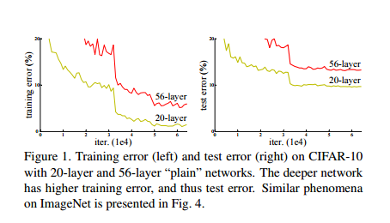
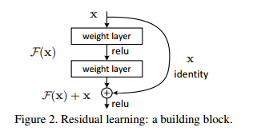
Related works
--Deep Residual Networks
Notes:
RESNET2015年在ImageNet和COCO比赛中共5个领域取得第一名：ImageNet recognition, ImageNet detection, ImageNet localization, COCO detection, and COCO segmentation
这个152层ResNet架构深，除了在层数上面创纪录，ResNet 的错误率也低得惊人，达到了3.6%，人类都大约在5%~10%的水平。
最近的证据表明网络深度是至关重要的，在挑战性的ImageNet数据集中领先结果的团队，都利用了“很深”模型，该深度为十六至三十。而且很多特殊的视觉识别任务也从深度模型中大大受益。出现了一个问题：学习更好的网络是否和叠加层数一样简单？解决该问题的一大障碍是臭名昭著的梯度爆发与消失问题，它从一开始就阻碍了收敛，随着BN层的出现，这一问题得到了较好的解决，在几十层卷积网络结构中，都能够通过SGD算法收敛。
精准度的下降并不是由过度拟合造成的，而且在相配的深度模式中增加更多的层数，会造成更高的训练误差。图1展示了一个经典的实例。文章提出假设：加入的后续层如果都能够做到将前一层的结果直接map到下一层的话，那么该加深后的网络理论上是保持一样的误差而不是增大训练误差了

Slide 10
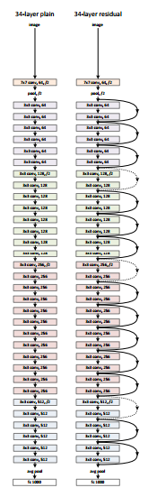
Related works
--Deep Residual Networks
Notes:
RESNET2015年在ImageNet和COCO比赛中共5个领域取得第一名：ImageNet recognition, ImageNet detection, ImageNet localization, COCO detection, and COCO segmentation
这个152层ResNet架构深，除了在层数上面创纪录，ResNet 的错误率也低得惊人，达到了3.6%，人类都大约在5%~10%的水平。
最近的证据表明网络深度是至关重要的，在挑战性的ImageNet数据集中领先结果的团队，都利用了“很深”模型，该深度为十六至三十。而且很多特殊的视觉识别任务也从深度模型中大大受益。出现了一个问题：学习更好的网络是否和叠加层数一样简单？解决该问题的一大障碍是臭名昭著的梯度爆发与消失问题，它从一开始就阻碍了收敛，随着BN层的出现，这一问题得到了较好的解决，在几十层卷积网络结构中，都能够通过SGD算法收敛。
精准度的下降并不是由过度拟合造成的，而且在相配的深度模式中增加更多的层数，会造成更高的训练误差。图1展示了一个经典的实例。文章提出假设：加入的后续层如果都能够做到将前一层的结果直接map到下一层的话，那么该加深后的网络理论上是保持一样的误差而不是增大训练误差了

Slide 11


Related works
--About enhanced feature
Data augmentation
《TI-POOLING: transformation-invariant pooling for feature
learning in Convolutional Neural Networks》 CVPR2016
Feature fusion
《Orientation robust object detection in aerial images using deep convolutional neural network》 ICIP2015
Enhanced convolution kernel
《Oriented Response Networks》CVPR2017
New loss function
《A Discriminative Feature Learning Approach for Deep Face Recognition》ECCV2016

Slide 12
Part 3
about

Slide 13
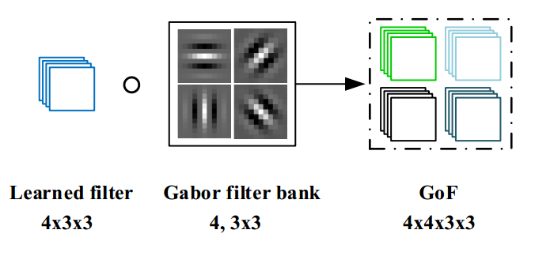
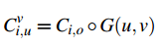
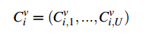
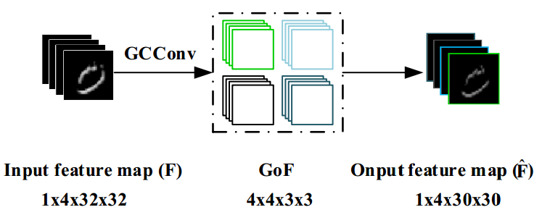
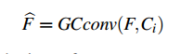
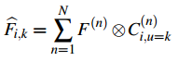
Gabor Convolution Nesworks
--GoFs and GCN
Convolutional Gabor orientation Filters (GoFs)
GCN convolution

Slide 14
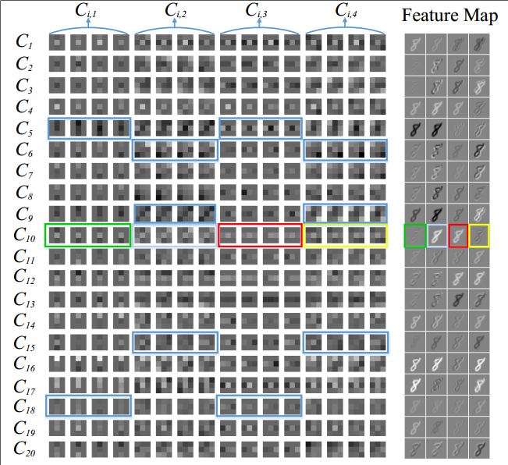
--GoFs and GCN
Gabor Convolution Nesworks
Visualization of the first Gabor Convolution Layer. Each row represents a group of GOFs and its corresponding feature map. i.e. (C10;1:::C10;4), which are signed by different color, are 4-orientation channel sub-kernels in 10th GoFs. The output feature map is also 4-orientation channel and the corresponding feature map is signed with the same color. The examples marked by blue rectangle are used to illustrate that some sub-kernel in GOFs carries different orientation information.

Slide 15
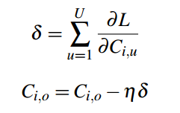
Gabor Convolution Nesworks
--Updating GoF
In the back-propagation (BP) process, only the leaned filer Ci,0 needs to be updated.

Slide 16
Part 4
about

Slide 17
Experiments
--MNIST
MNIST database of handwritten digits, has a training set of 60,000 examples, and a test set of 10,000 examples.The digits have been size-normalized and centered in a fixed-size image.

Slide 18
Experiments
--MNIST
Orientation Channel Experiment
Scale Experiment
Results on
MNIST-rot
Results on MNIST

Slide 19
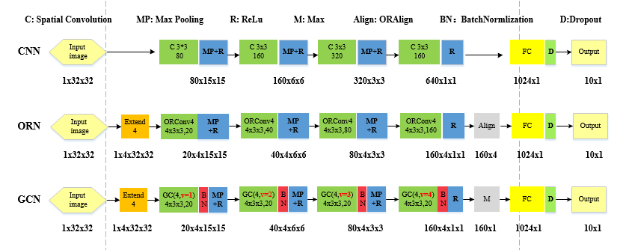
Experiment
--Network Structure
Batch size : 128 learning rate decay:0.5 initial learning rate : 0.001
epoch step: 25 max epoch 200 weight decay : 0.00005

Slide 20
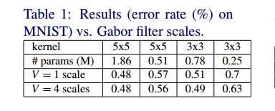
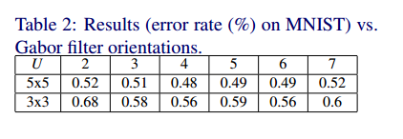
Experiment
--Orientation channel experiment --Scale experiment

Slide 21
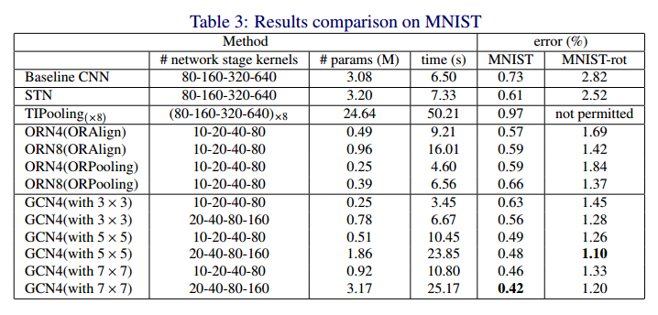
Experiment
--Results on MNIST and MNIST-rot

Slide 22
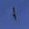
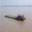
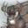

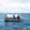
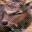

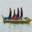
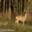
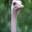

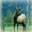
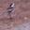

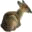


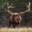


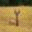
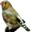

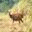
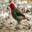
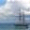

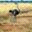

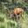
Experiment
--CIFAR
CIFAR-10 and CIFAR-100
60000 32x32-sized color images
10 /100 classes 6000/600 images per class
50000 training images 10000 test images

Slide 23
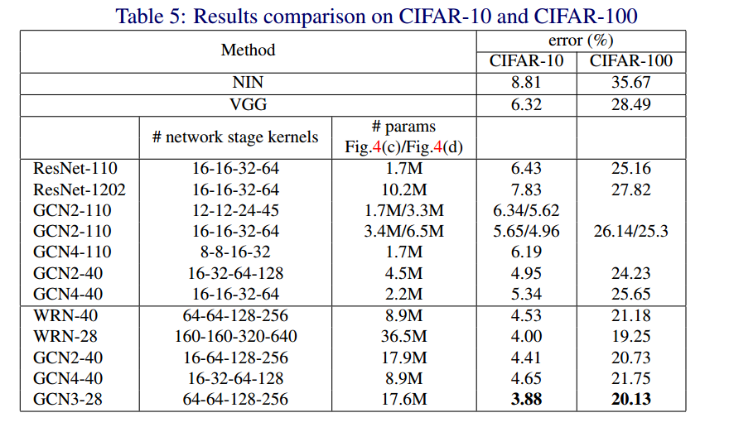
Experiment
--CIFAR

Slide 24
Experiment
--CIFAR

Slide 25
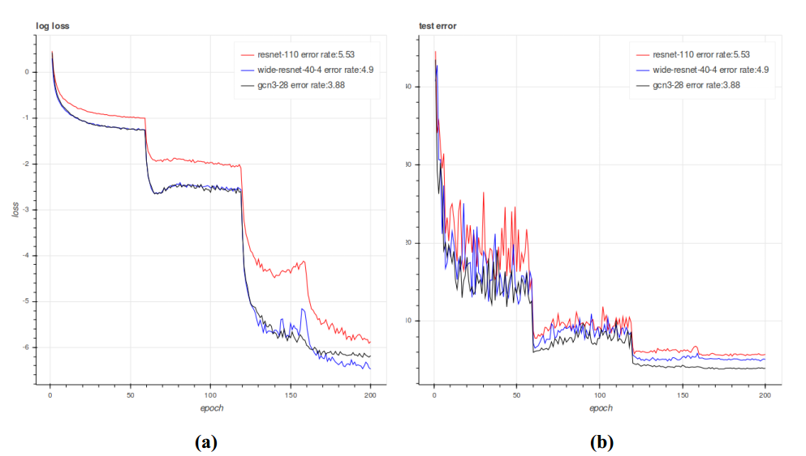
Experiment
Training loss and testing error on CIFAR-10
--CIFAR

Slide 26
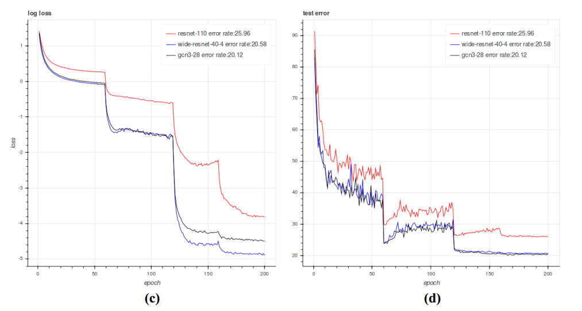
Experiment
Training loss and testing error on CIFAR-100
--CIFAR

Slide 27
Remote sensing Image Classification
NWPU-RESISC45 Dataset* contains 31,500 images, covering 45 scene classes with 700 images in each class.
TABLE 1
Comparison to the state-of-the-art methods on NWPU-RESISC45 in terms of accuracy(%)on test set.
Features | Training Ratio | Accuracy
AlexNet GCN WRN | 20% | 79.85 85.95
* A publicly available benchmark for REmote Sensing Image Scene Classification (RESISC), created by Northwestern Polytechnical University (NWPU)

Slide 28
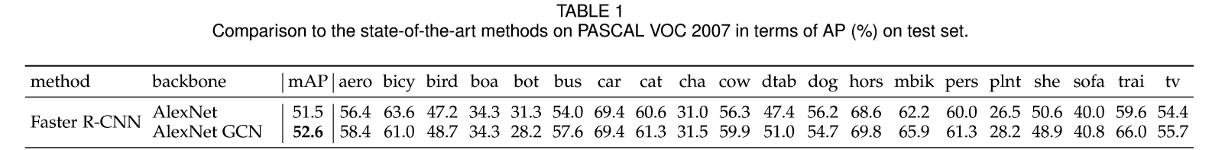
Experiment
The PASCAL VOC 2007 [7] consists of 2,501 training, 2,510 validation, and 4,092 test images with bounding box annotationsfor20categories.
Object detection
We train Faster R-CNN on Gabor CNNs with the similar AlexNet architecture

Slide 29
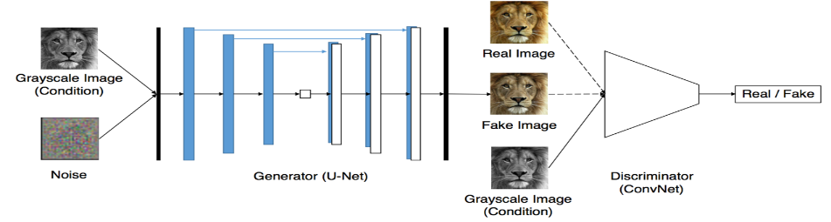
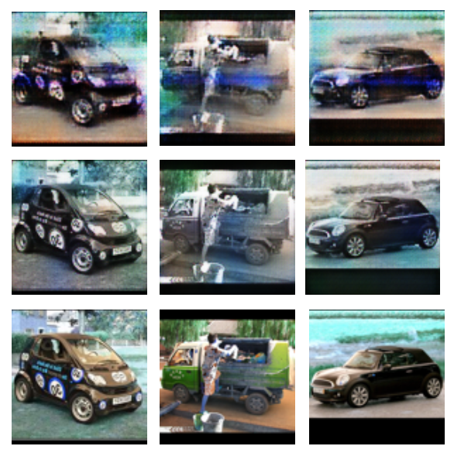
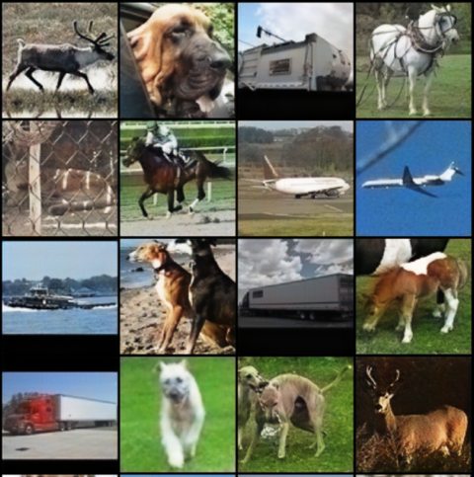
Experiment
GAN

Slide 30
THANKS
Paper transfer gate: https://arxiv.org/pdf/1705.01450.pdf

